Slide 1

6th Sem Self Study Phase -1 Evaluation
TOPIC
NAME USN
Department of Computer Science & Engineering
R V College of Engineering, Bangalore

Slide 2
Problem Statement
Identification of Problem
Application of Engineering Principles
Study of existing system and designing the problem
Methodology
Correlation with Self-study Subjects
Selection of tools, skills and techniques in solving problem
Future work for Phase 2
References

Slide 3
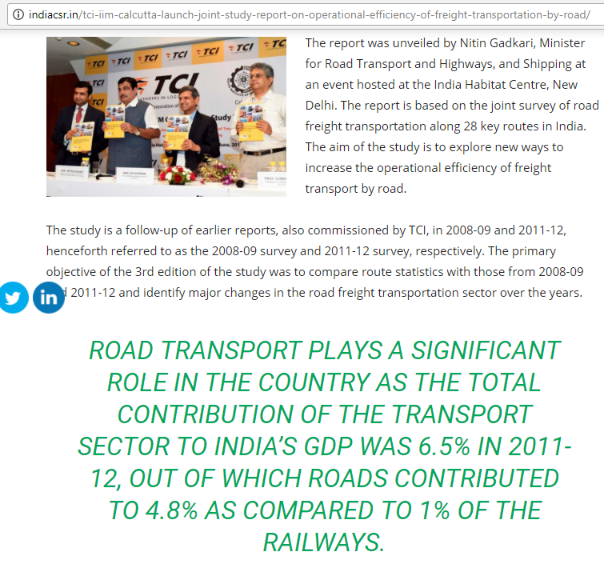
Problem Statement
Focus Area : Road Transport

Slide 4
Consider the present day tolling stations
Assume 100 vehicles crossing the booth with an average waiting time of 1 minute
This equals approx. delay of 6 hours for each car per year
However in real life the numbers are much larger
On Gurugao-Delhi highway this count can go to 180000 cars/day
The national average waiting time at toll booth comes to about 10 minutes

Slide 5
A report by TCI(Transport Corporation of India ) & IIM Calcutta in 2013 says
“
The slow truck speed on highways and delays at toll plazas costs country about Rs 60,000 crores a year
”

Slide 6
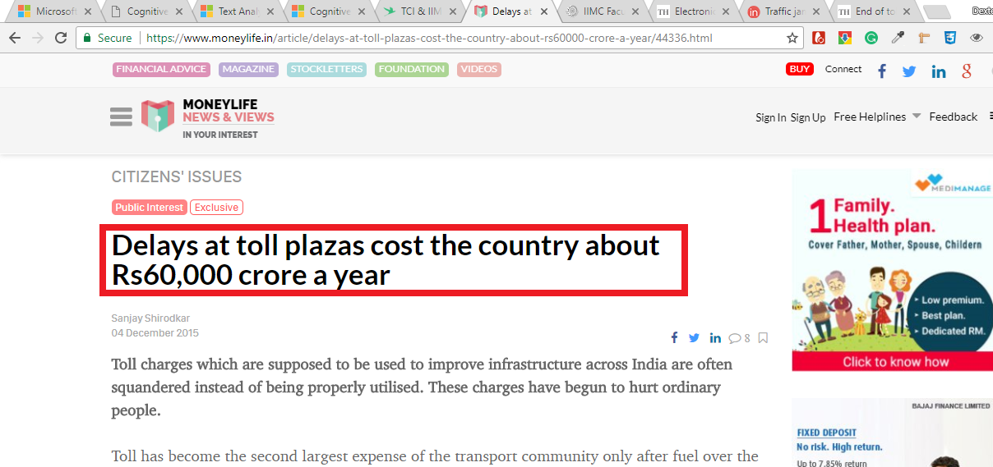

Slide 7
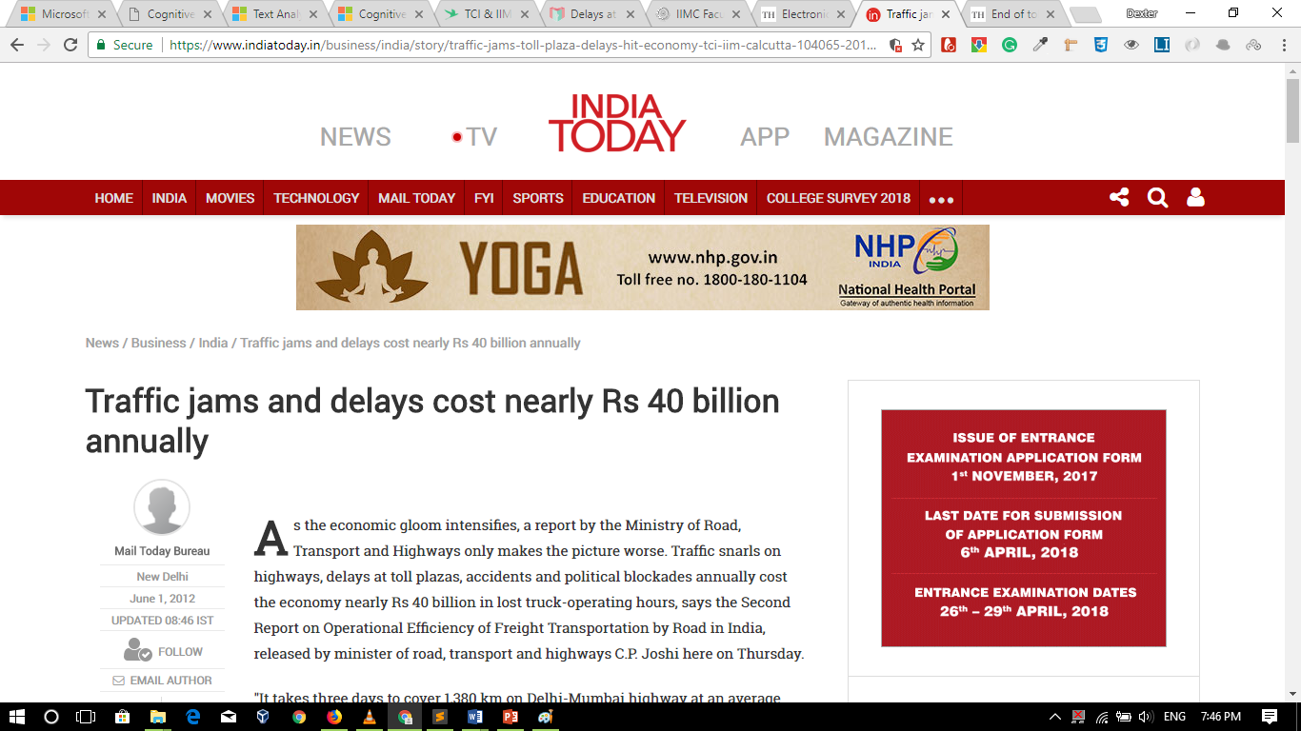

Slide 8
2-3 % of GDP

Slide 9
Other Big Issues:
How accounts are maintained for collection of money through toll
There is massive Under reporting of Vehicles that pay report due to which concessionaries are getting a longer tenure to collect tolls
consider the fact that inspite of 10% annual growth in vehicle number the toll collection has either remained same or infact decreased
The delays lead to increased carbon emissions

Slide 10
Existing System
ETC(electronic Toll collection)
It uses a RFID sensor in form of a transponder
It consists of an active transponder that stores a unique serial number associated with a user's personal account.
Many systems include a passive tag in the device as well.
When the passive tag comes within range of a reader, it tells the sleeping active tag to wake up and broadcast.
The passive reader in the toll booth constantly emits a signal instructing any transponders that enter the read field to wake up

Slide 11
Existing System
ETC(electronic Toll collection)
It uses a RFID sensor in form of a transponder
It consists of an active transponder that stores a unique serial number associated with a user's personal account.
Many systems include a passive tag in the device as well.
When the passive tag comes within range of a reader, it tells the sleeping active tag to wake up and broadcast.
The passive reader in the toll booth constantly emits a signal instructing any transponders that enter the read field to wake up

Slide 12
Existing System
Limitations
The onus to implement hardware into car is on many occasions on the general public or the Vehicle companies
In some cases the they need a power supply and have a limited life
Due to hardware specifications the vehicles need to be confined in narrow lanes so that the transponders can interact which increases the dangers of high speed collisions with confinement
Inspite of using ETC ,the car lane length have not decreased in many countries

Slide 13
Existing System
LIMITATIONS
Variation in vehicle dimensions and placing of the transponder can lead to inaccurate readings
Instead using CV & ML can be used to implement additional functionality like
1)OCR to read vehicle number & Classify vehicle.
2)mapping driver face to license
3)detection of safety measure like safety belts, helmets etc.
4)In near future to predict drunk driving(Not been implimeted till now).

Slide 14
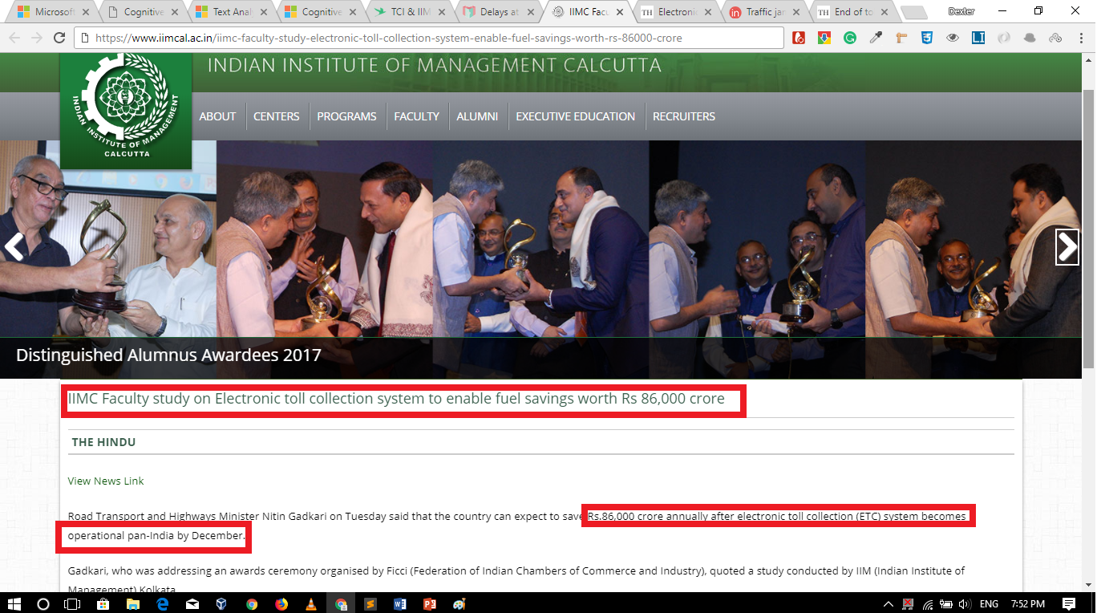
SUCCESS ?

